Slide 1
Databázové systémy přednáška 10 – Zálohování a archivace
Roman Danel
Institut ekonomiky a systémů řízení
2016

Slide 2
Struktura SQL serveru
*.MDF – primary data file
*.NDF – secondary data file
*.LDF – log file

Slide 3
Systémové db
master Database
Records all the system-level information for an instance of SQL Server.
msdb Database
Is used by SQL Server Agent for scheduling alerts and jobs.
model Database
Is used as the template for all databases created on the instance of SQL Server. Modifications made to the model database, such as database size, collation, recovery model, and other database options, are applied to any databases created afterward.
Resource Database
Is a read-only database that contains system objects that are included with SQL Server. System objects are physically persisted in the Resource database, but they logically appear in the sys schema of every database.
tempdb Database
Is a workspace for holding temporary objects or intermediate result sets.

Slide 4
Stavy databáze
ONLINE
OFFLINE
RESTORING
RECOVERING
RECOVERY PENDING – error during recovery
SUSPECT – primary filegroup is damage…
EMEREGNCY – single-user mode

Slide 5
Stavy zrcadlení
SYNCHRONIZING
SYNCHRONIZED
SUSPENDED – the mirror copy of the db is not available
PENDING_FAILOVER – on principal after failover
DISCONNECTED – partner lost communication

Slide 6
Recovery modely databáze
SIMPLE
BULK-LOGGED
FULL
Při použití technologie zrcadlení musí být použit model FULL

Slide 7
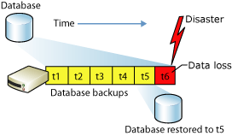
Simple recovery model
Can recover only to the end of a backup.
Zdroj: Microsoft MSDN

Slide 8
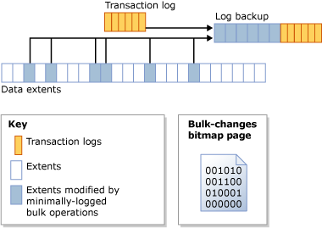
Bulk-logged recovery mode

Slide 9
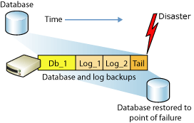
Full recovery mode
Can recover to a specific point in time, assuming that your backups are complete up to that point in time
Notes:
The following illustration shows the easiest backup strategy under the full recovery model. In the illustration, a full database backup, Db_1, and two routine log backup, Log_1 and Log_2, have been taken.Some time after the Log_2 log backup, data loss occurs in the database.Before these three backups are restored, the database administrator must back up the active log (the tail of the log).The database administrator then restores Db_1, Log_1, and Log_2 without recovering the database.Then the database administrator restores and recovers the tail-log backup (Tail).This recovers the database to the point of failure, recovering all the data.

Slide 10
Backup
Full database backup
Differential backups
BACKUP DATABASE db_name TO DISK=‚filename‘ WITH DIFFERENTIAL
Transaction log backup
Záloha transakčního logu
nelze v simple modelu

Slide 11
BACKUP DATABASE [DBname] TO DISK = N'C:\Backup\DBname.bak' WITH NAME = 'DBname-Full Database Backup
Backup devices – disk nebo páska
Od 2008 – backup compression
Backup by se měl zverifikovat!

Slide 12
Differential Backup
BACKUP DATABASE [DBname] TO DISK = N'C:\Backup\DBname-diff1.bak' WITH DIFFERENTIAL, NAME = 'DBname-Differential Database Backup'

Slide 13
Záloha logu
BACKUP LOG [DBname] TO DISK = N'C:\Backup\DBname.LOG.bak' WITH NAME = 'DBname-Transaction Log Backup'

Slide 14
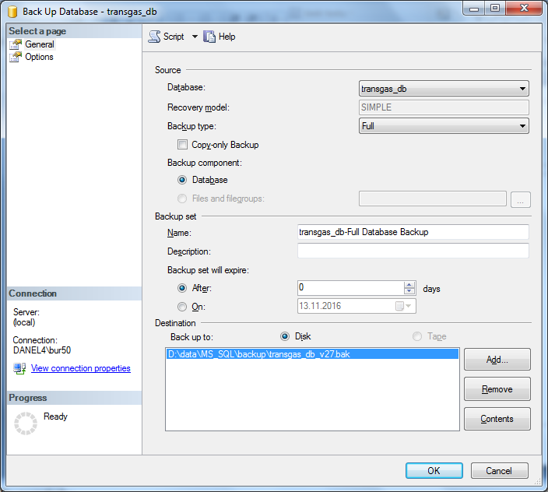

Slide 15
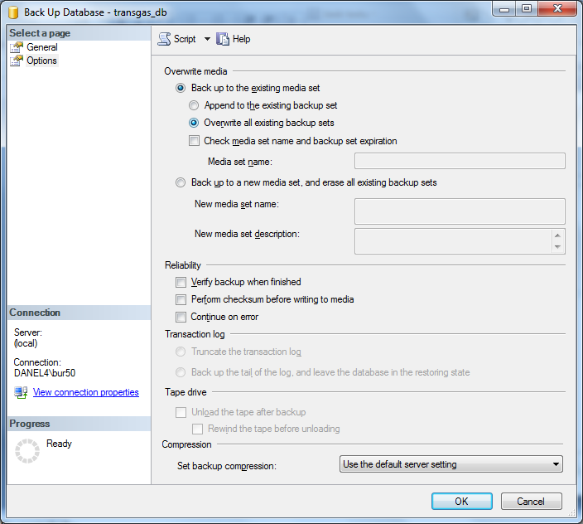

Slide 16
Obnova (Restore)
RESTORE DATABASE db_name FROM DISK=‚C:\DATA\db_name.BAK‘ WITH REPLACE

Slide 17
Restore (recovery)
RESTORE DATABASE db_name FROM DISK=‚C:\DATA\db_name.BAK‘ WITH RECOVERY/NORECOVERY
Transaction log chain

Slide 18
Validation a Backup
RESTORE VERIFYONLY FROM backup_device

Slide 19
MS SQL Server Recovery Mode
ALTER DATABASE jmeno_db SET Recovery (Full|Bulk_Logged|Simple)

Slide 20
Moving database
ATTACH/DETACH
use db_name
exec sp_change_users_login 'Update_one', login_name, login_name

Slide 21
BCP
Bulk copy program
Nezapisuje se do logu

Slide 22
Shrinking Files
Remove unused pages
AUTO_SHRINK – not recommended
DBCC SHRINKDATABASE(db_name, par)
Shrink database transaction logs

Slide 23
DBCC
Database Console Commands
Maintenance
Validation
Informational
Progress Reporting

Slide 24
DBCC CHECKDB
Check for integrity issues
Database must be in single-user mode
DBCC CHECKDB
DBCC CHECKALLOC
DBCC CHECKTABLE
DBCC CHECKCATALOG
Validates Servicer Broker
Validate context of indexes

